Slide 1

38: ProtoControl
Kelly Mae Allen, Abisha Fenn, Nida Kosedagi, Parker Sexton, William Wood
Notes:
Intro
Example user and how competitors don’t meet their needs
Functional Block Diagrams
System
User Flow
Subsystems
Designing a User Interface
Website
Peripherals
Implementation with User Interface
Integration (command library)
Communication
Microcontroller change
Functionality while systems running
Embedded
PCB
Power
Enclosure
Conclusion
“That’s why Shannon chooses protocontrol”
Demo Day Plans
Demo
Questions

Slide 2
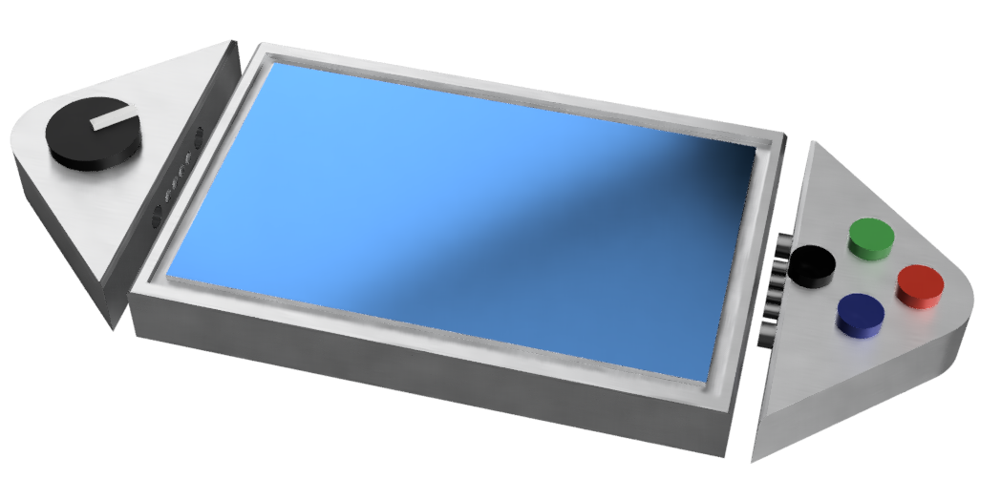
What is ProtoControl?
A plug and play panel with a start-to-finish user interface development experience.
Software platform to design user interface layout
Auto generated embedded code
Touch-screen display
Hot swappable hardware
Compatibility with industry standard technology
Nida Kosedagi
Notes:
Protocontrol allows engineers and hobbyists to execute their vision for a user interface panel with a start-to-finish user interface development experience
Bring the audience to the same place as us before diving into details, set the tone, differentiate ourselves from other projects

Slide 3


Example Users
Shannon
Senior Embedded Engineer
Tasked with designing a test bench for a production line
Needs to have prototype ready ASAP
Julia
10th Grade
Familiar with simple block coding
Wants to make cool projects
Needs to easily display values
Notes:
Meet Julia. Julia represents our hobbyist market. Julia is in 10th grade. She has some experience with simple block coding but wants to branch out with some personal projects. Unlike Shannon, her critical constraint isn’t time. She needs something that can manage complexity without having a high barrier to entry.

Slide 4
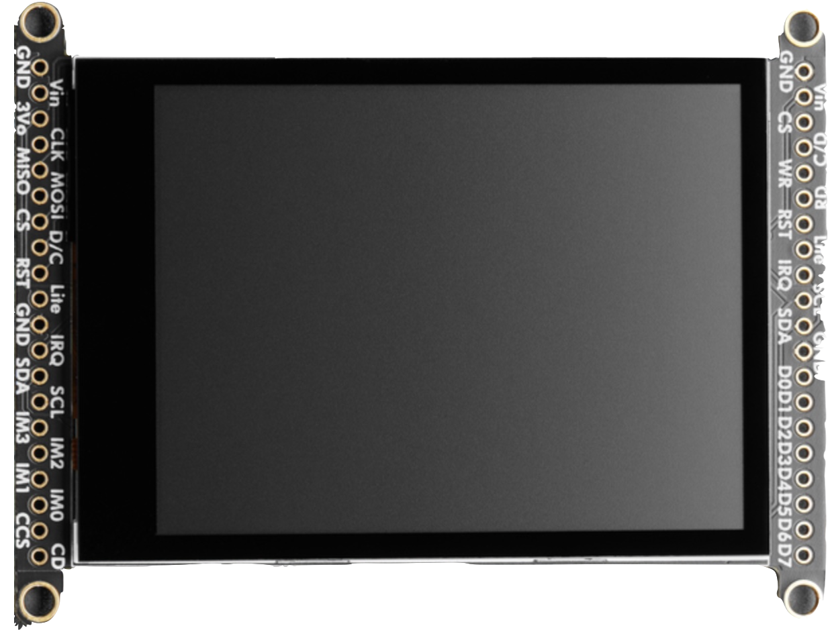
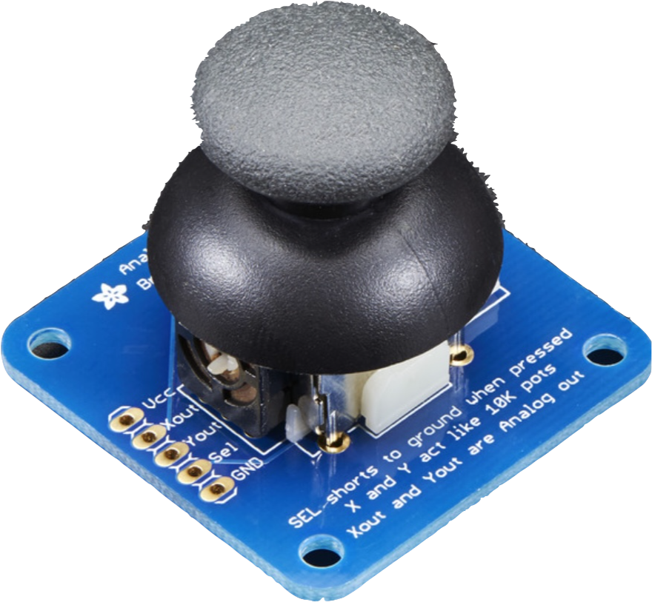
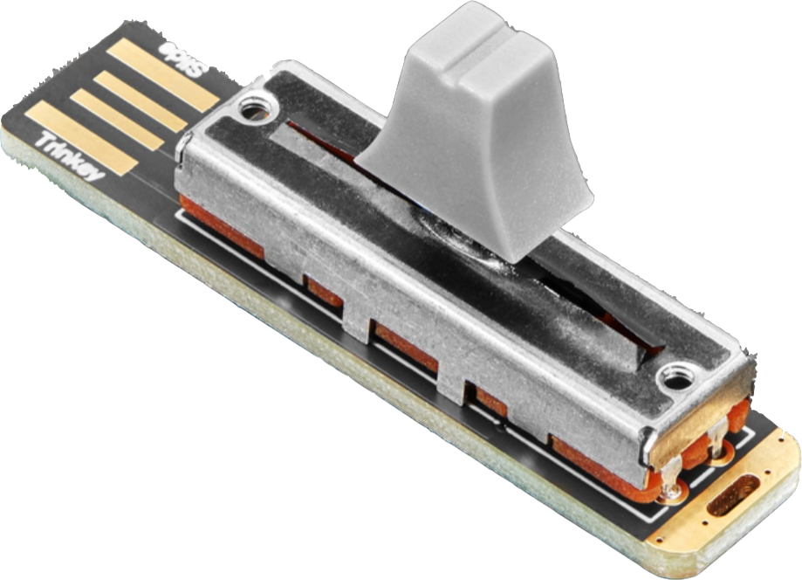
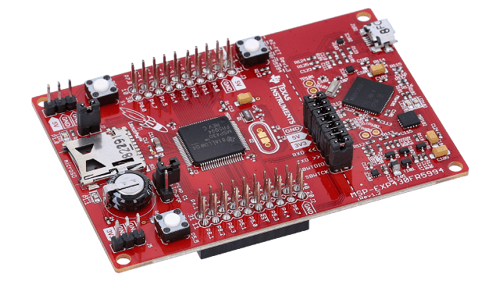
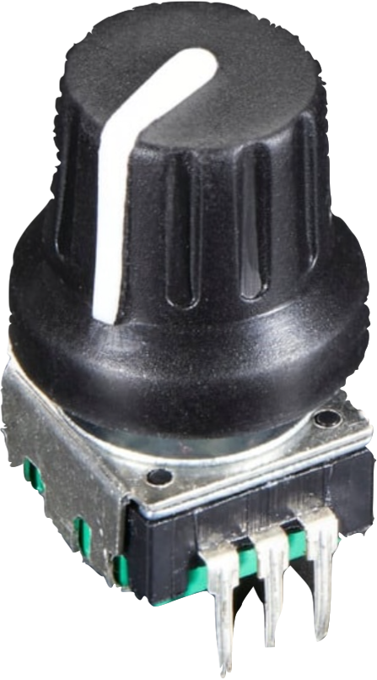
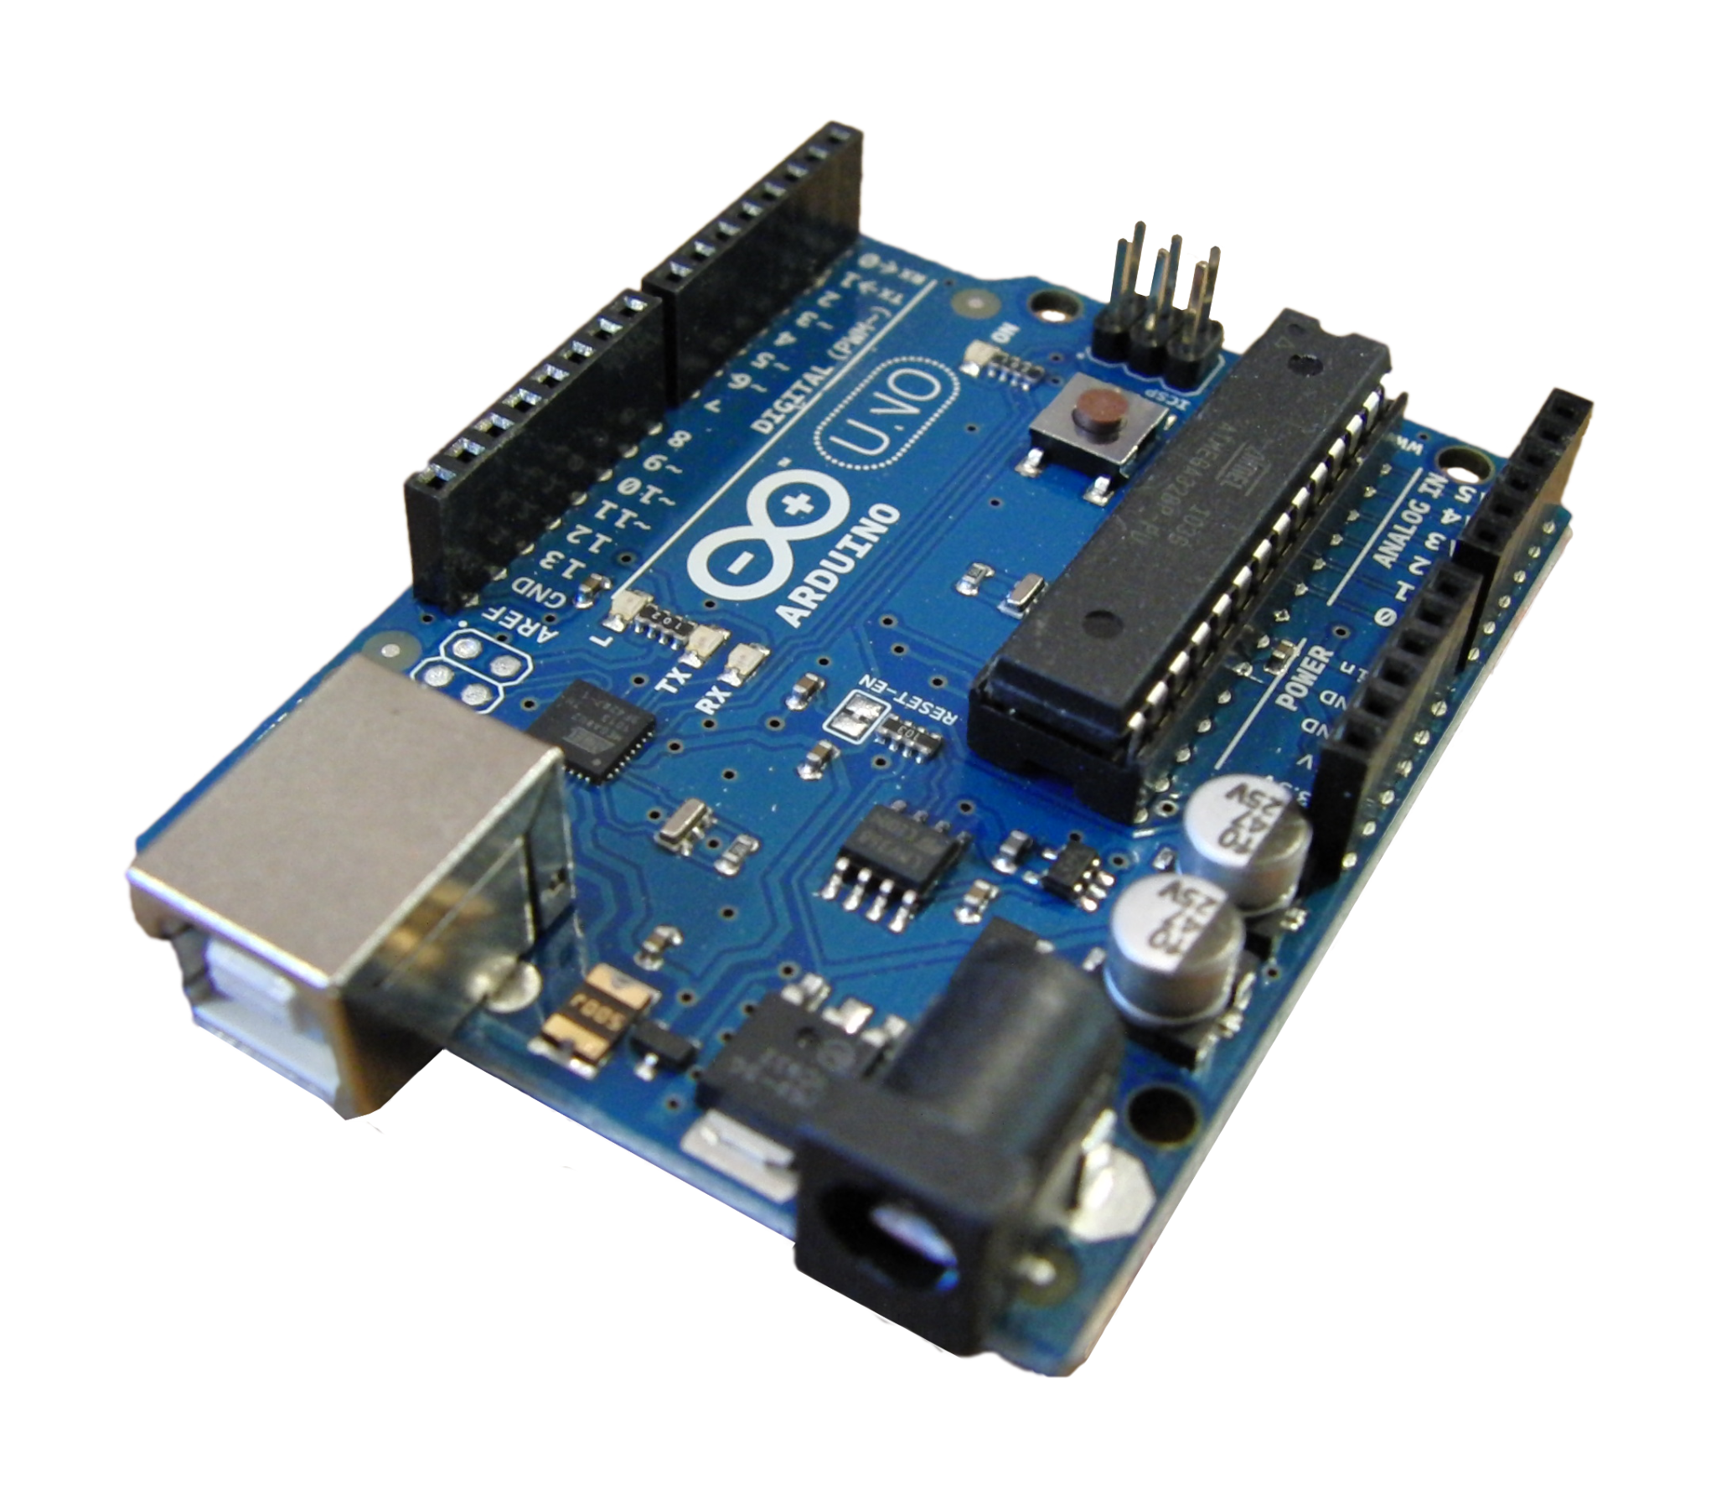
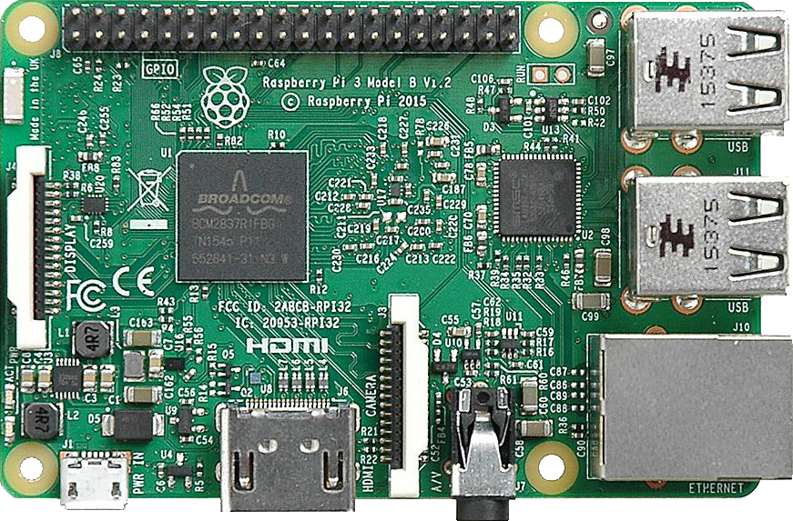
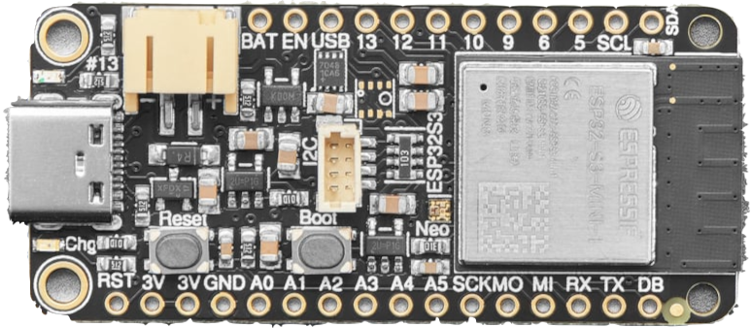
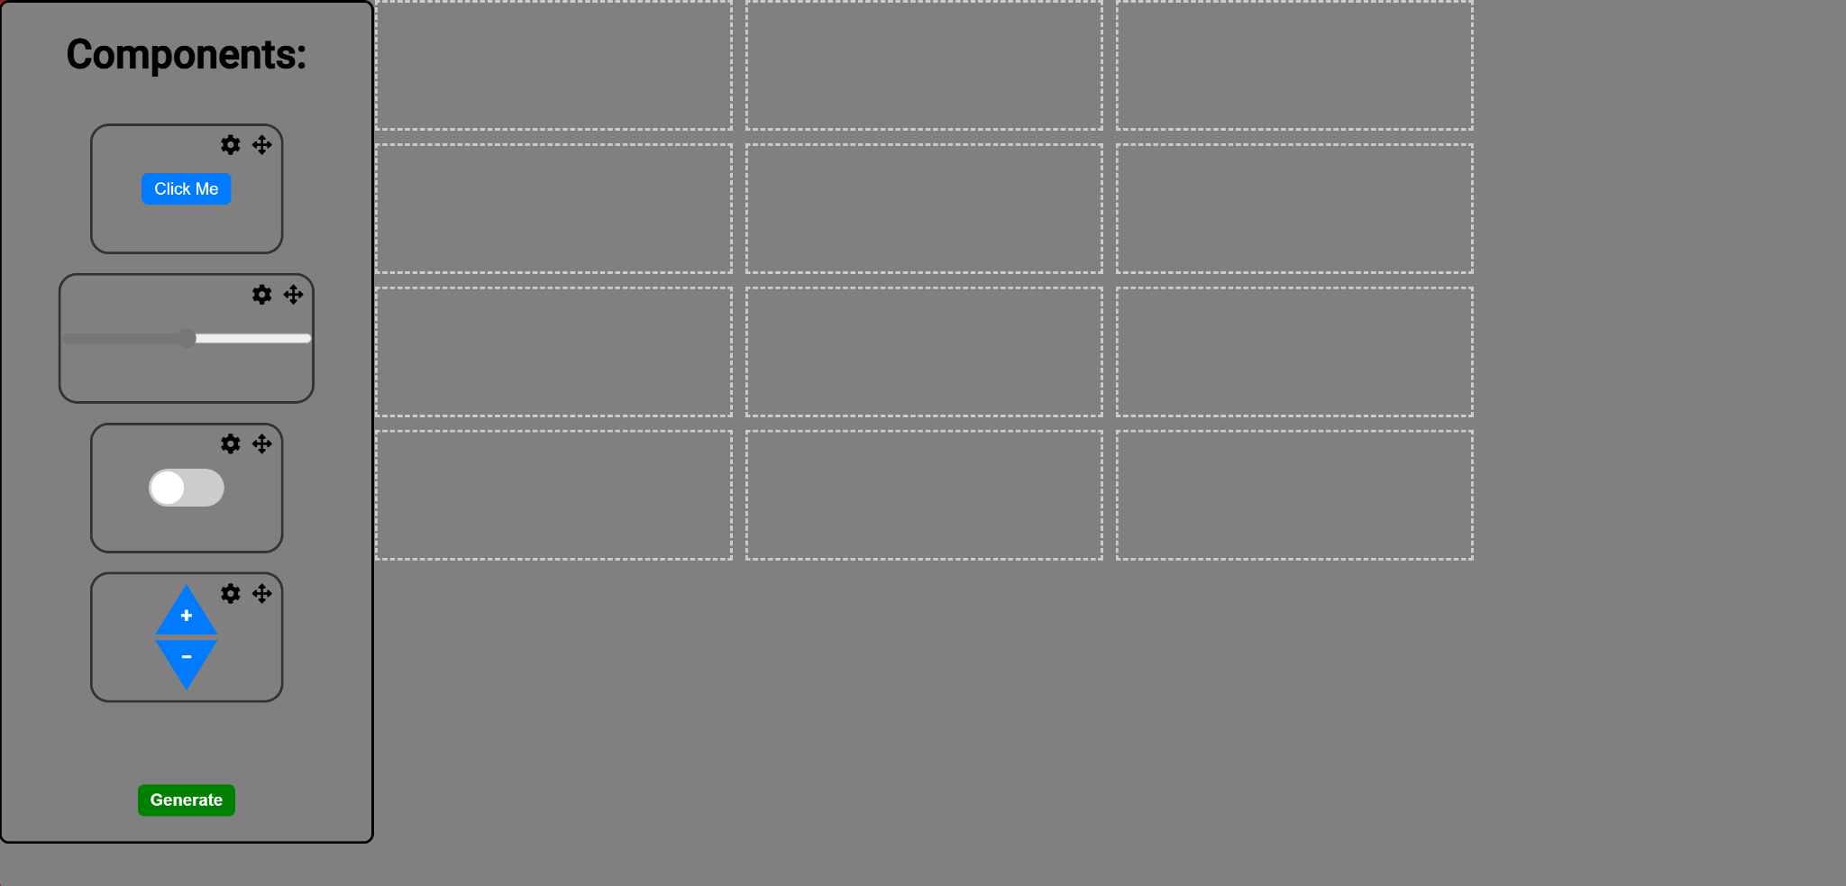
Functional Block Diagram
Display
I2C
I2C Peripherals
SPI
UART
WIFI
User System
Microcontroller
Website

Slide 5
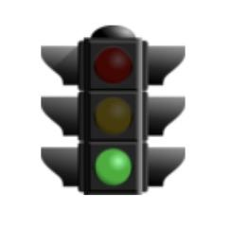
Updates and Project Status
Number | Description | Status
Website | Website prototype, Full database and UI connected
Embedded | Components working, Talking to website dynamically
PCB | PCB printed and tested, updates underway
I2C | Keypad nearly finished, Keypad and pcf libraries integrated with main protocontrol, user system started
Power | Power tested for current system, no current tasks
Comm | Method developed, integration in progress
Enclosure | Model in progress
General | Waiting for purchase order
Notes:
Mention that we are on track except for receiving purchase order

Slide 6
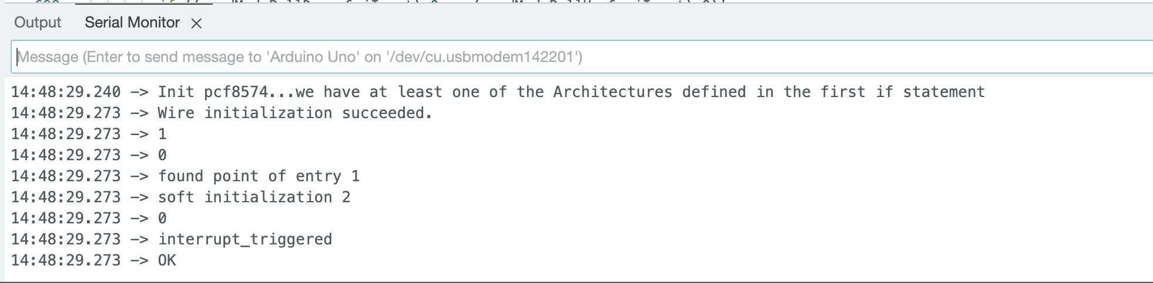
Hardware Peripherals/Embedded Code Updates
Integrated Keypad Library with PCF8574 Library
Integrated the above file with the rest of protocontrol
Started User System
Notes:
The final ‘OK’ indicates that pcf8574.begin(0x20) has successfully completed
The fact that Keypad doesn’t have a ground might be a problem?

Slide 7
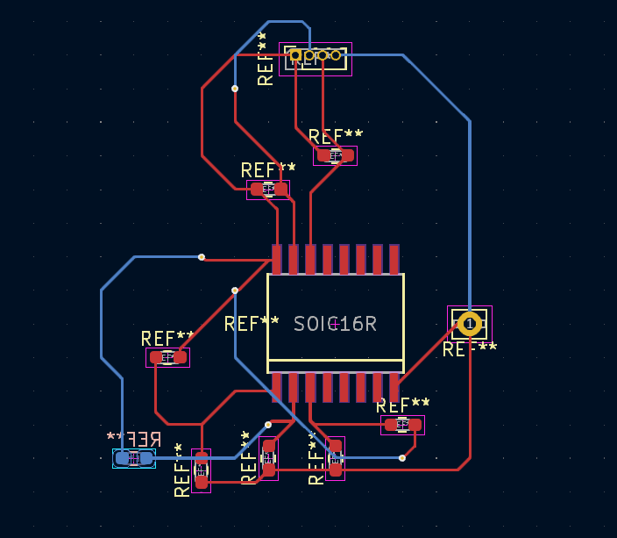
PCB Design
Redesigned the component PCB after review with mentor
Added solder pads for the address lines
Got rid of the loop traces
New main board design in progress

Slide 8
Website Progress
https://pages.github.ncsu.edu/ECE-Senior-Design-Fa2023-Sp2024/38-Protocontrol/
https://protocontrol.pythonanywhere.com/retrieve-all

Slide 9
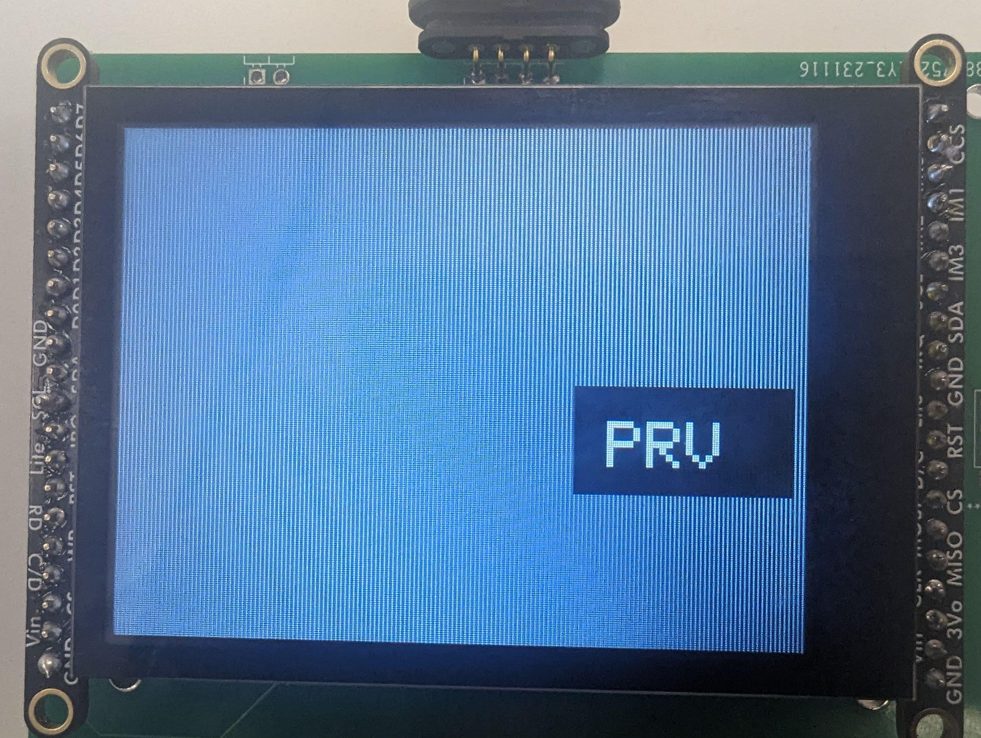
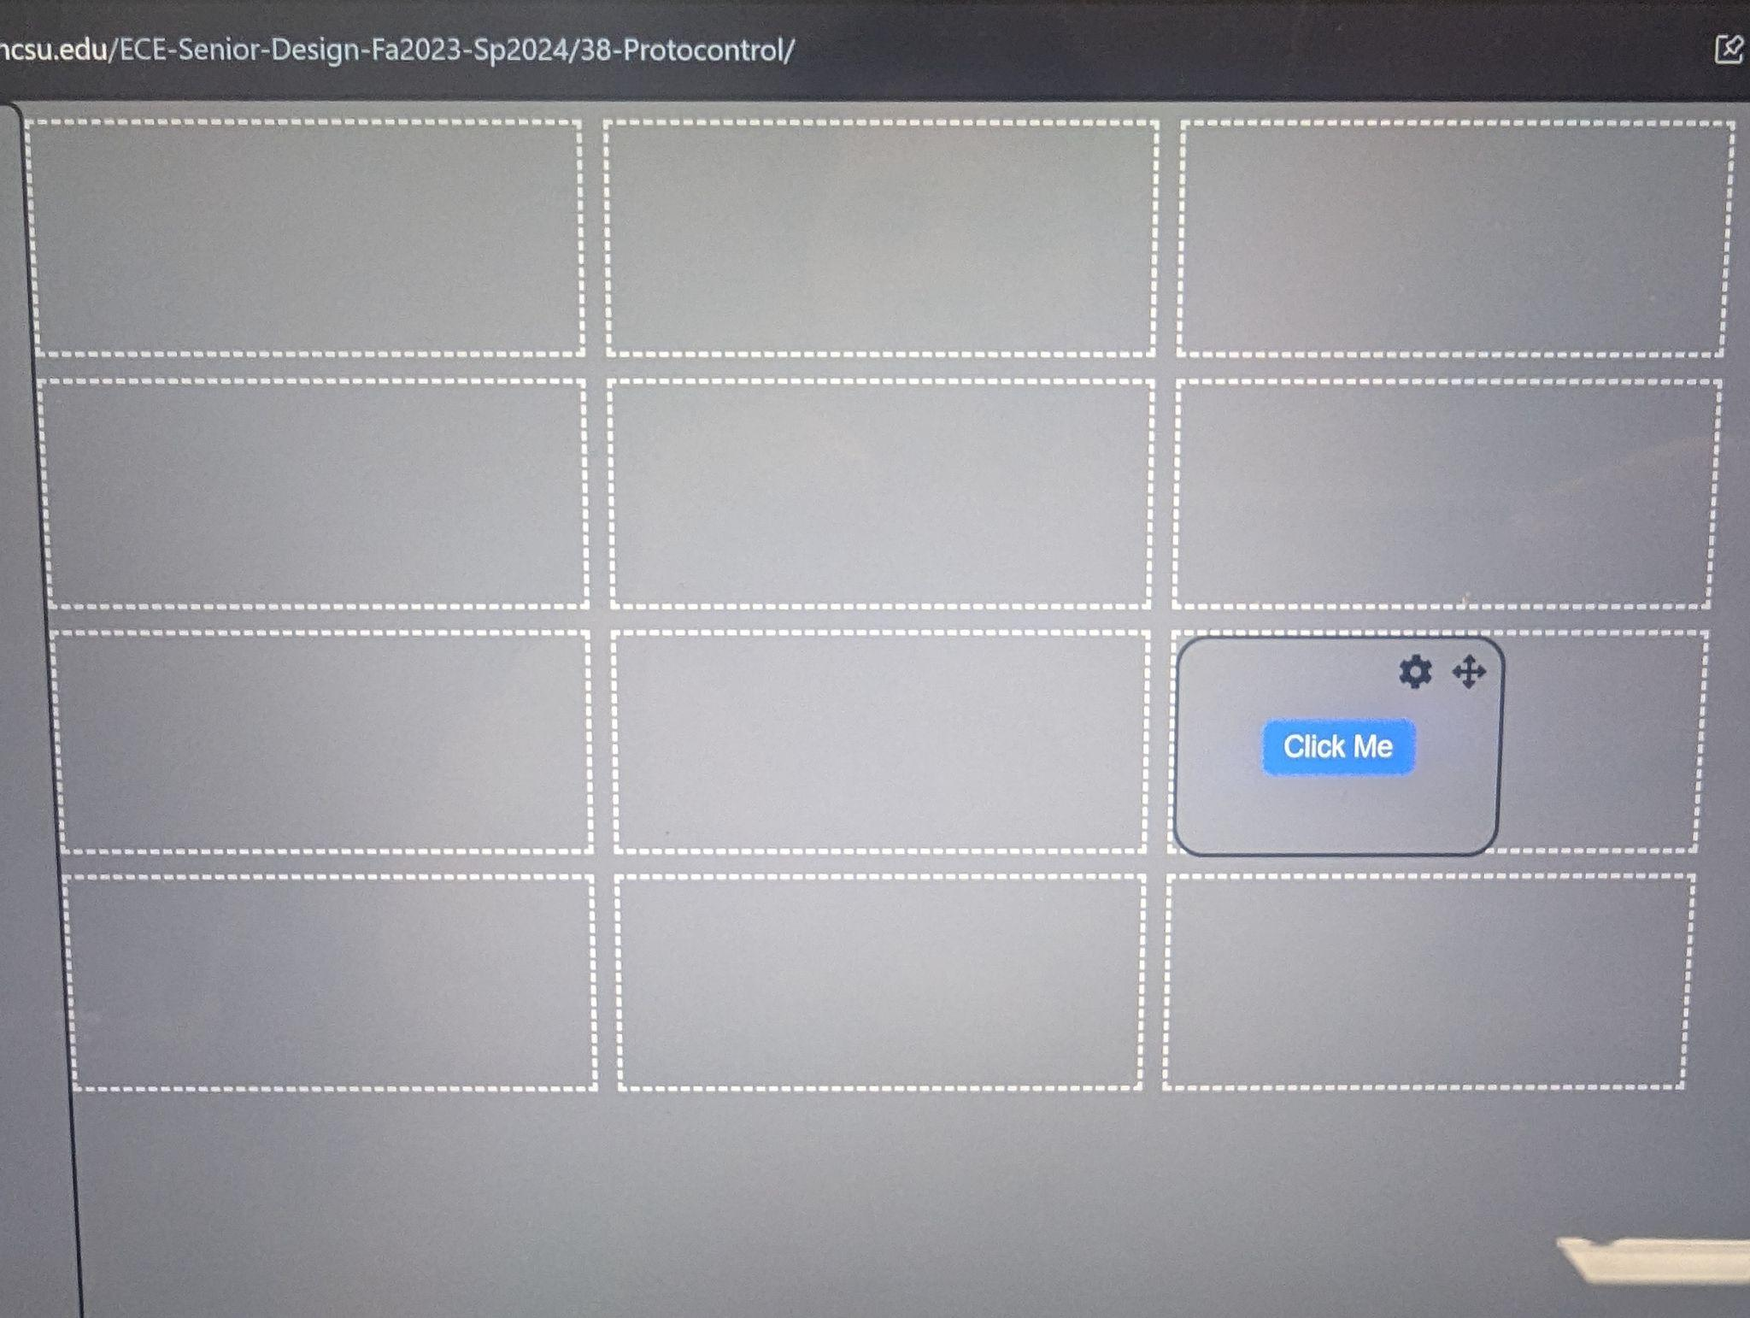
Embedded progress
IOT connected!
String parsing from website
PushButton,215,120,0,0xFFFF,PRV,|,

Slide 10
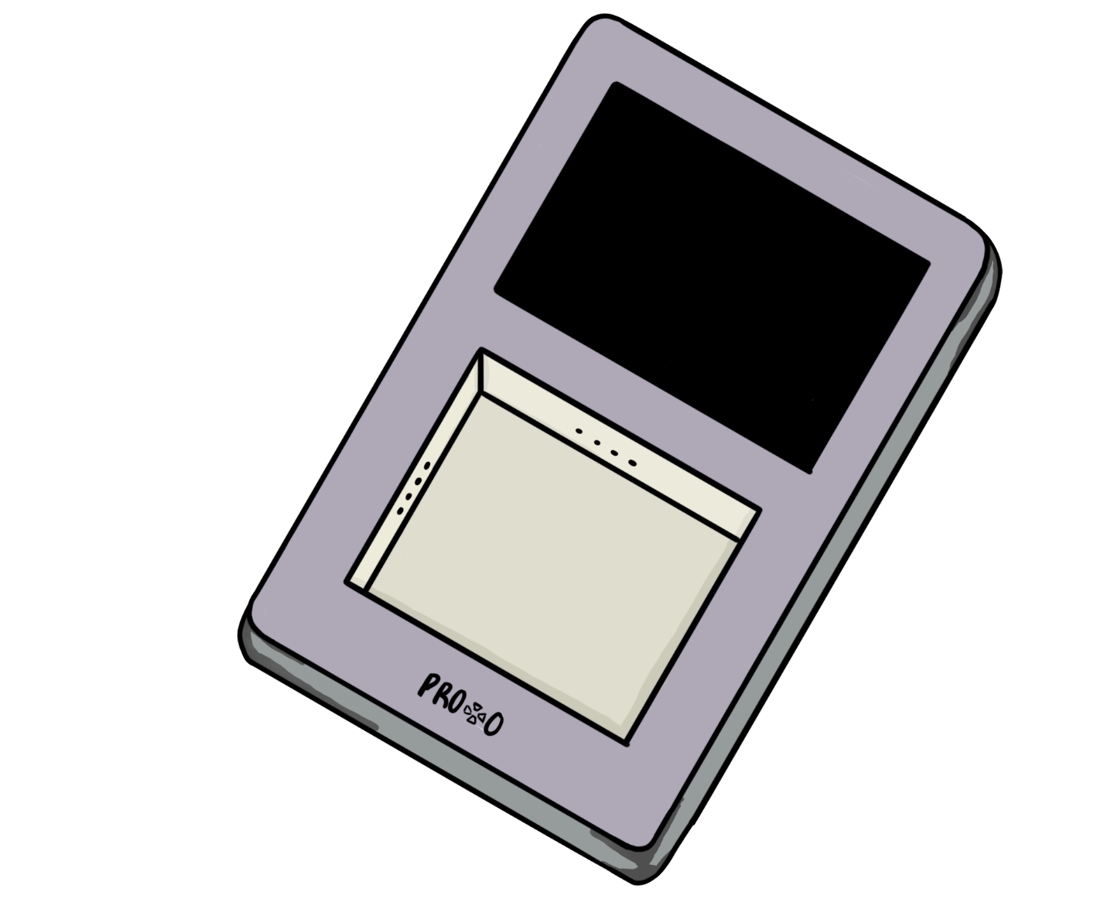
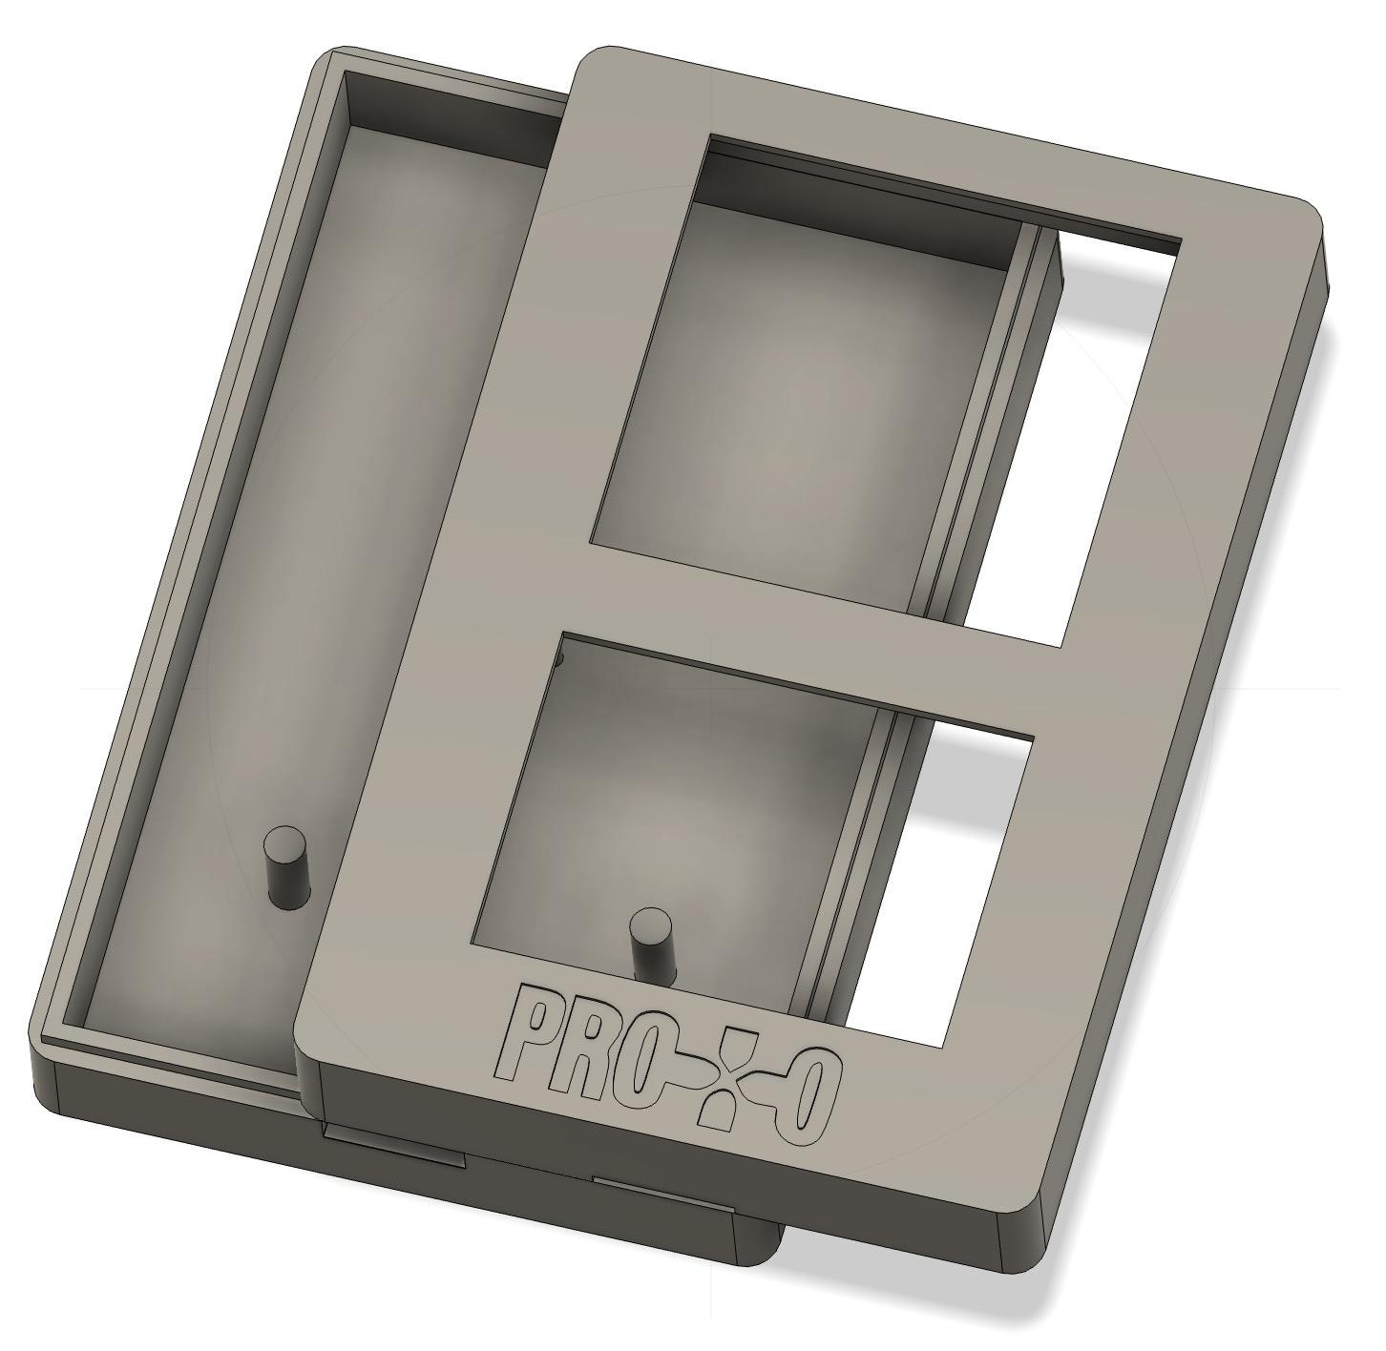
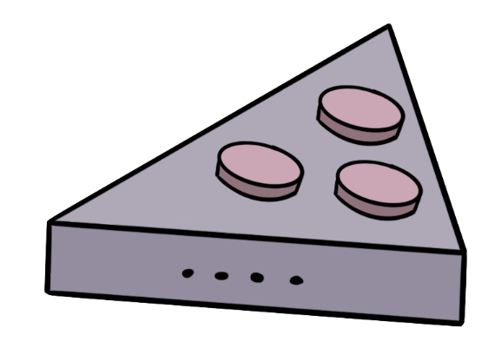

Integration and Enclosure Progress
Integration
Enclosure
Decided on message format
send(ID,value)
X = receive_update
Utilizing binary messaging across UART channel to capacity used
Building Arduino Library for simple user implementation
Printed new design
Sent purchase order for custom connectors
Fusion360 Design
Sketch

Slide 11

Team Charter

